Slide 1
Intro to jQuery
Week 10

Slide 2
What is jQuery?
JavaScript library that makes manipulating HTML easier and more efficient

Slide 3
Manipulation?

Slide 4

What jQuery can do
Previous student work: brandonlchow.github.io/shibas_of_instagram
Notes:
Javascript can do this too since jQuery is JavaScript under the hood, but it’d take much more effort and code writing

Slide 5
Library?

Slide 6

Notes:
JavaScript: making pasta from scratch (hard)
jQuery: buying boxed pasta — allows you to skip all the hard stuff!

Slide 7
Pure JavaScript vs. jQuery
let el = document.getElementById("div1");
function fadeIn(el) {
el.style.opacity = 0;
const tick = function() {
el.style.opacity = +el.style.opacity + 0.01;
if (+el.style.opacity < 1) {
(window.requestAnimationFrame &&
requestAnimationFrame(tick)) ||
setTimeout(tick, 16)
}
};
tick();
}
fadeIn(el);
$("#div1").fadeIn()
Notes:
Actual code behind this jQuery implementation! I think.

Slide 8
tl;dr
It makes writing JavaScript easier

Slide 9
Questions?

Slide 10
Using jQuery

Slide 11
Linking HTML and JavaScript file
How will the HTML file know where to find its codin’ ?!
Inside the <head> tag, add this line:
<script type="text/javascript" src="assets/scripts/main.js"></script>
*No need to memorize this — just copy and paste or something like that
Notes:
Same as before, must link script

Slide 12
Adding the jQuery Library
How will the HTML file know where to find its jQuery ?!
Inside the <head> tag, add this line:
<script type="text/javascript" src="http://code.jquery.com/jquery-1.11.3.min.js"></script>
Make sure to include this before your other JavaScript files
Notes:
Why before? We will be using our jQuery shorthand in your JavaScript, so we have to make sure our browser loads jQuery before we use our shorthand in our script.js so it knows what the shorthand means.

Slide 13
Adding the jQuery Library
How will the HTML file know where to find its jQuery ?!
Inside the <head> tag, add this line:
<script type="text/javascript" src="http://code.jquery.com/jquery-1.11.3.min.js"></script>
Make sure to include this before your other JavaScript files
Notes:
This is the link to jquery yum

Slide 14
Setting up jQuery in your JavaScript file
Add this line to your JavaScript file, and write all your code within the curly braces.
$(document).ready(function() {
// jQuery and JavaScript code goes in here!
});
Notes:
What this mean? we will explain later hehe

Slide 15
Quick note about loading scripts
Order of execution dependent on load order
Loading is unpredictable: HTML first or JS first? Depends.
Old convention: add scripts after body tags
New convention: add defer attribute to script tag
defer: execute script after HTML document is parsed
<script type="text/javascript" src="assets/scripts/main.js" defer></script>
Notes:
Don’t need to do this for the jQuery file since we want that done as soon as possible

Slide 16
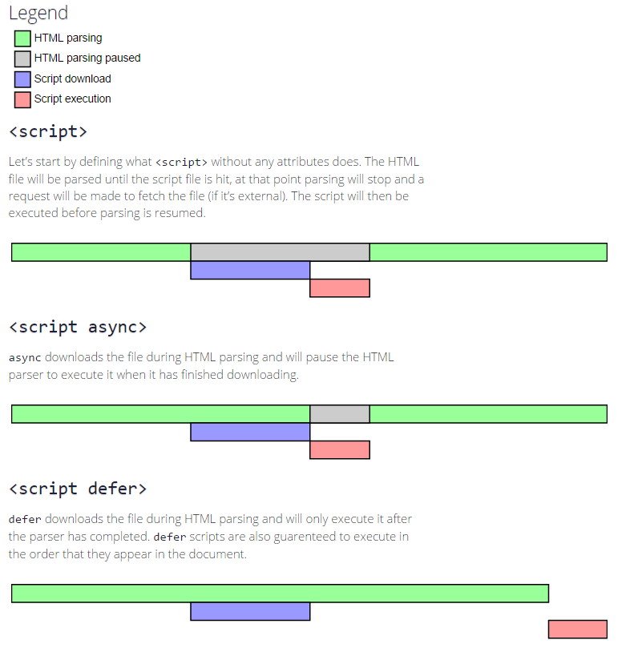
More on script attributes
More reading on script tag attributes:
https://stackoverflow.com/questions/10808109/script-tag-async-defer
Notes:
Don’t need to do this for the jQuery file since we want that done as soon as possible

Slide 17
Questions?

Slide 18
How we select + identify elements

Slide 19
Grabbing elements by id and class: HTML
HTML
<div id="id-name"></div>
<div class="class-name"></div>
<div></div>

Slide 20
Grabbing elements by id and class: CSS
HTML
CSS
<div id="id-name"></div>
<div class="class-name"></div>
<div></div>
#id-name {}
.class-name {}
div {}

Slide 21
Grabbing elements by id and class: jQuery!
HTML
CSS
jQuery
<div id="id-name"></div>
<div class="class-name"></div>
<div></div>
#id-name {}
.class-name {}
div {}
$("#id-name")
$(".class-name")
$("div")
Notes:
Notice parallels between the CSS selectors and the jQuery selectors?

Slide 22
jQuery Selectors

Slide 23
$("#id-name")

Slide 24
$("#id-name")
selector goes here

Slide 25
$("#id-name")

Slide 26
$("#id-name")
selects
<div id="id-name"></div>

Slide 27
Can also use more advanced selectors!
For whichever combination of CSS selectors, we can also use to select elements in jQuery.
// all dog class elements with div ancestors
$("div .dog")
// selects all elements with both class1 and class2
$(".class1.class2")
// selects elements with either the id id-name or the class class3 (or both!)
$("#id-name, .class3")

Slide 28
Questions?

Slide 29
jQuery Methods

Slide 30
What are methods?
“actions” objects can execute or respond to
Execute
fadeIn
fadeOut
Respond
hover
click

Slide 31
Dot notation
How methods are called
Perform actions on jQuery selectors
Each one does different things!
// when button is hovered over
$(".button").hover()
// when button is clicked
$(".button”).click()
// make image fade in
$("#image").fadeIn()
// made div fade out
$("div").fadeOut()

Slide 32
Dot notation: selected element
This is how I select my element
I want to use this element with the id of “image”
// make image fade in
$("#image").fadeIn()

Slide 33
Dot notation: action
This is what I want the selected element to do
In this case, I want it to fade in
// make image fade in
$("#image").fadeIn()

Slide 34
Dot notation: additional info
Inside the parentheses, additional information is given to the action/method
What/how to do it
In this case, take 200ms (0.2s) to fade in
// make image fade in
$("#image").fadeIn(200)

Slide 35
Dot notation: additional info
For “responding” jQuery methods, the additional information will be a function to execute in response to the event
// when we click on the button, the
// image will fade in.
$("#button").click(function() {
// code that should execute
// when the button is clicked
// on.
$("#image").fadeIn(200)
})

Slide 36
Questions?

Slide 37
Setting up jQuery in your JavaScript file - revisited!
This makes sure the HTML document is parsed and ready before executing jQuery code
Step-by-step:
Grabs document with selector
Uses ready to method to check
Executes everything inside the function
$(document).ready(function() {
// jQuery code goes in here!
});
Notes:
What would happen if we tried to select an element before the document has loaded? The element wouldn’t exist. so things would break.

Slide 38
Some useful jQuery
Name | Use
$(".elem").click() | Run the code below when you click on the element with class ‘elem’
$(".elem").hover( cursor-enter, cursor-exit) | Run first function when your cursor enters the element and run second function when it leaves the element
$(".elem").css("color”, "red") | Change the color of elem to red
$(".elem").fadeIn() | Fade in element
$(".elem").fadeOut() | Fade out element
$(".elem").show() / $(".elem").hide() | Add/remove display: none from element

Slide 39
jQuery Resources
Some good references for more information
http://api.jquery.com/
https://www.w3schools.com/jquery/

Slide 40
Demo
https://tinyurl.com/wdd-jquery-click

Slide 41
Takeaways
It’s really easy to change the CSS of an element in jQuery
It’s really easy to change the CSS of an element in response to another element in jQuery
$(this) = the specific element from a set of elements with the same class

Slide 42
Demo
https://tinyurl.com/wdd-jquery-toggle

Slide 43
Takeaways
It’s really easy to change the CSS of an element in jQuery
It’s really easy to change the CSS of an element in response to another element in jQuery
$(this) = the specific element from a set of elements with the same class
It’s really easy to change the CSS of an element using another element in jQuery

Slide 44
Demo
https://tinyurl.com/wdd-jquery-shapeshift

Slide 45
Takeaways
It’s really easy to change the CSS of an element in jQuery
It’s really easy to change the CSS of an element in response to another element in jQuery
$(this) = the specific element from a set of elements with the same class
It’s really easy to change the CSS of an element using another element in jQuery
Adding new “sets” of styling (that is, classes) to an element is really easy

Slide 46
Questions?

